Slide 1
Probabilistic Learning

Slide 2
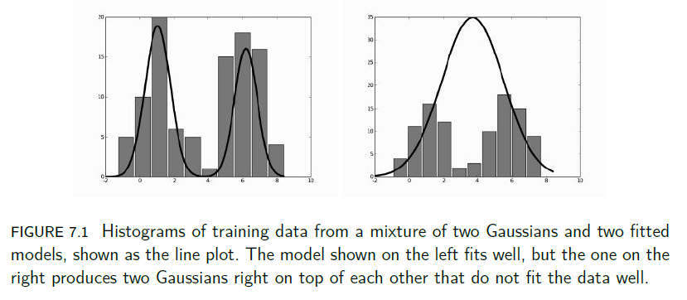


Gaussian Mixture Models

Slide 3
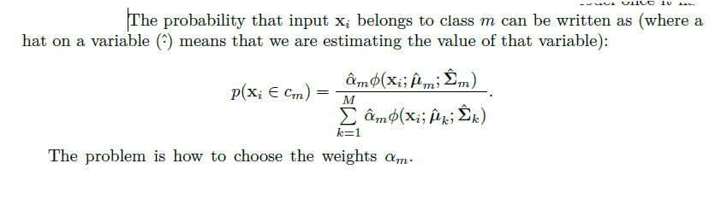
The common approach is to aim for the maximum likelihood solution (the likelihood is the conditional probability of the data given the model, and the maximum likelihood solution varies the model to maximise this conditional probability).
In fact, it is common to compute the log likelihood and then to maximise that; it is guaranteed to be negative, since probabilities are all less than 1, and the logarithm spreads out the values, making the optimisation more effective.

Slide 4
The Expectation-Maximisation (EM) Algorithm
The basic idea of the EM algorithm is that sometimes it is easier to add extra variables that are not actually known (called hidden or latent variables) and then to maximise the function over those variables.

Slide 5
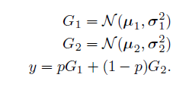

Consider the simplest interesting case of the Gaussian mixture model: a combination of just two Gaussian mixtures.
The assumption now is that data were created by randomly choosing one of two possible Gaussians, and then creating a sample from that Gaussian.
If the probability of picking Gaussian one is p, then the entire model looks like this
If the probability distribution of p is written as π , then the probability density is:

Slide 6

If f = 0 then the data came from Gaussian one, if f = 1 then it came from Gaussian two.
This is the typical initial step of an EM algorithm: adding latent variables.
Now we just need to work out how to optimise over them.
We don’t know much about variable f, but we can compute its expectation (which is the mean average) from the data:
where D denotes the data. Note that since we have set f = 1 this means that we are choosing Gaussian two.

Slide 7
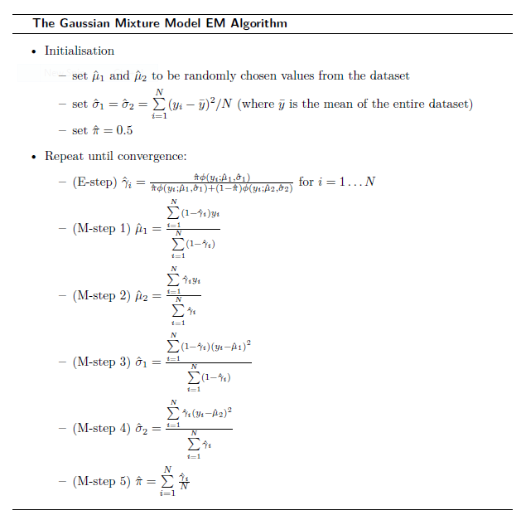

Slide 8
